Slide 1
Recruiting is a Mindset Recruiting is an all-the-time thing

Slide 2
A recruit is not a recruit until he or she has a recruit!

Slide 3
You
Your
Recruit
Their
Recruit

Slide 4
A leg is not a leg until it is 4 deep!

Slide 5
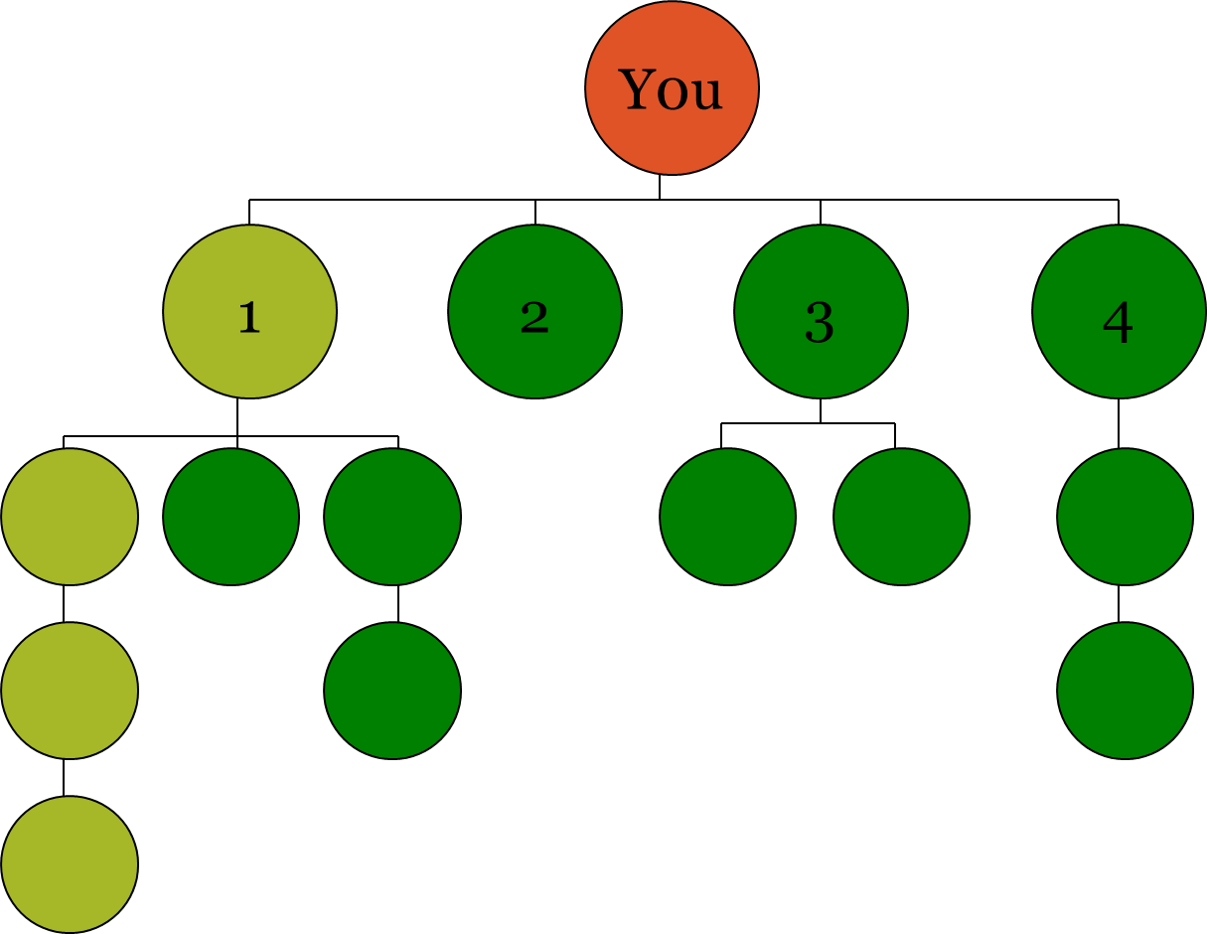

Slide 6
A team is not a team until it has 4 legs!

Slide 7
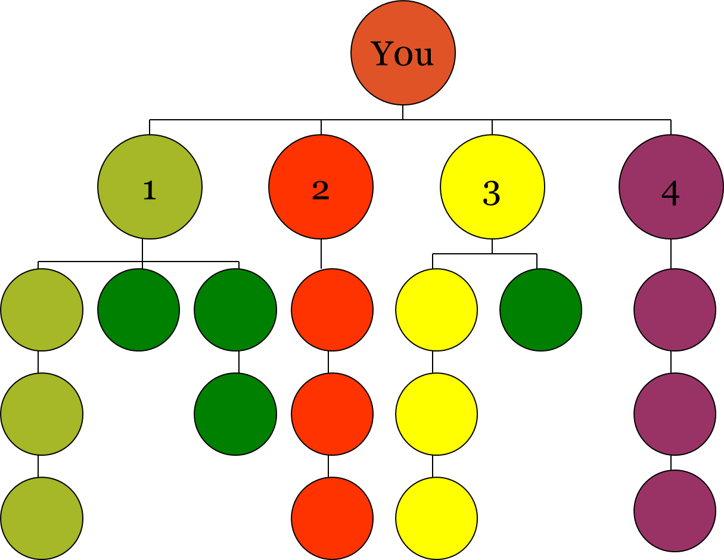

Slide 8
There is very little you can do to move people! When you recruit someone, don’t go to the bathroom until you have gotten them with a recruit!

Slide 9
BIG & FAST

Slide 10
I am a recruiter

