Slide 1


Builder’s Basic Training
Prospecting
Prospecting
Approach
Presentation
Follow Up
Start Up
Duplication
Notes:
Trainer Action:
Add to new recruits existing prospect/inventory list (Name 5 or 5 or STEAM)
New recruits practice the script (call on each of them)
Share next 6 Step Class

Slide 2
Prospecting: The CORNERSTONE of our business!!!

Slide 3
Definition of a prospect:
Any person who may or may not be interested in your business or products.
(Either as associate or as client)
Notes:
Speakers notes:
This means anyone breathing is at least a referral source for your business!

Slide 4
Biggest Mistake:
Deciding for people without giving them the opportunity to see your presentation
Notes:
Speakers notes:
We tend to qualify people into categories based on what we think we know about them. We want to give everyone a chance to hear the Primerica Story

Slide 5
Frances Avrett’s Marigold Theory
Notes:
Speakers notes:
You can’t pick “the winners.” You have to put everyone in the system, they will decide what they are going to do!

Slide 6
Your Prospect List is step one of the Marketing System. It is important to take step one before you take step two. Your PROSPECT LIST is the INVENTORY for your business. You must have inventory before you can turn on the cash registers and open the doors for business.
Notes:
Speakers notes:
You bring excitement and a list to the table. Your Field Trainer brings knowledge and expertise. Together, you form a partnership to build your business.

Slide 7
DO NOT PREJUDGE!!
Phase 2 of your Prospect List is to add names to it and move names off it every day.
Notes:
Speakers notes:
Round One – Brain Dump
Round Two – Memory Jogger or Phone Contact List or 5 Minute Game or all!!
Phase 2 – You add by getting referrals, you take names off by setting presentations with your list

Slide 8
Always have your receiver on, your antenna up, and your scanner on looking EVERYWHERE you go for people and names to add to your list. It may be a new friend or merchant you’ve just met who will become a PROSPECT. You should identify at least 12 names that you will approach each week. These names are your weekly TARGET. HIT YOUR TARGET!!
Notes:
Speakers notes:
This is Cold Market Prospecting and Friendship Farming

Slide 9
Keep your prospect list growing daily with new names!
Prospecting is an all the time thing!

Slide 10
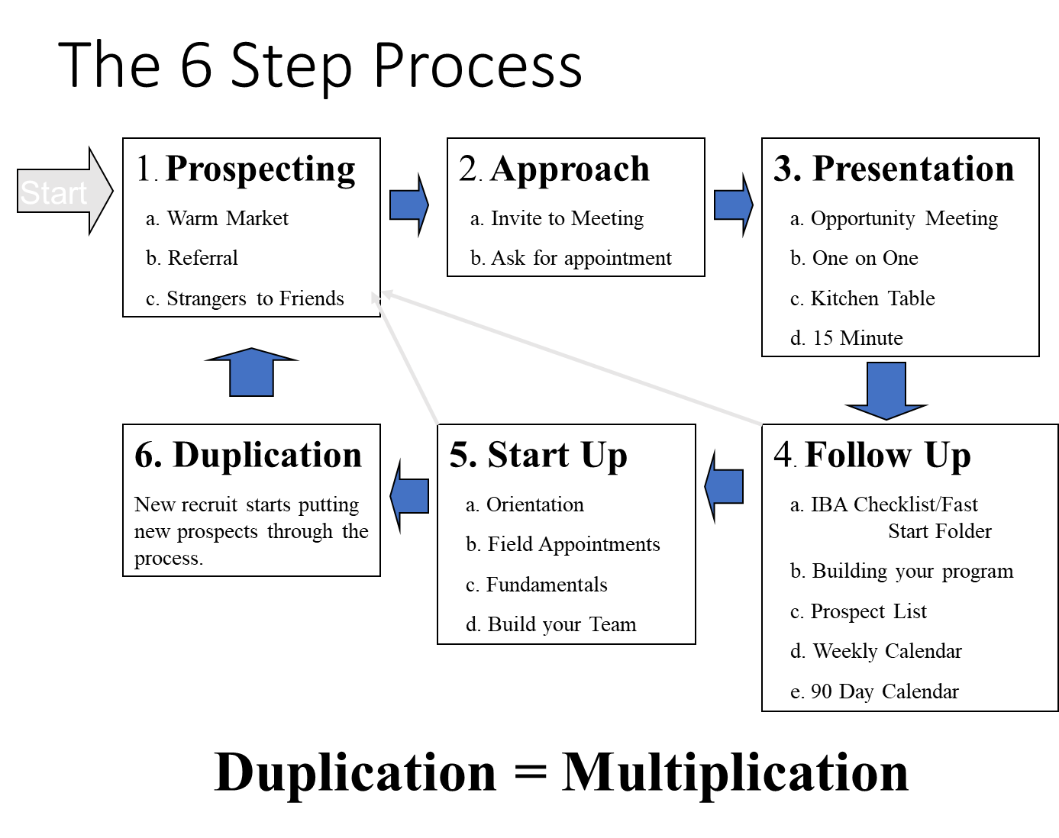

Slide 11
6 Fundamental Skillsets
Prospecting
Approach
Presentation
Follow Up
Start Up
Duplication
Notes:
Speakers notes:
Always review all 6 Skillsets

Slide 12
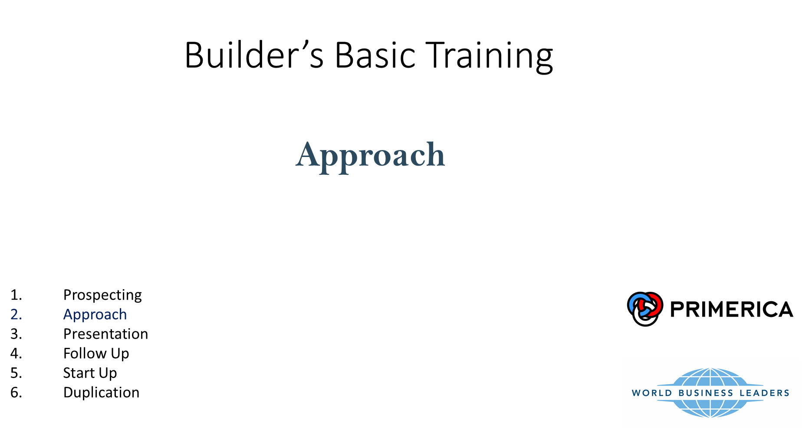
Notes:
Objective: Practice scripts

Slide 13
Purpose:
To create CURIOSITY and make a time to get the prospect to listen to the presentation.
SET AN APPOINTMENT!!

Slide 14
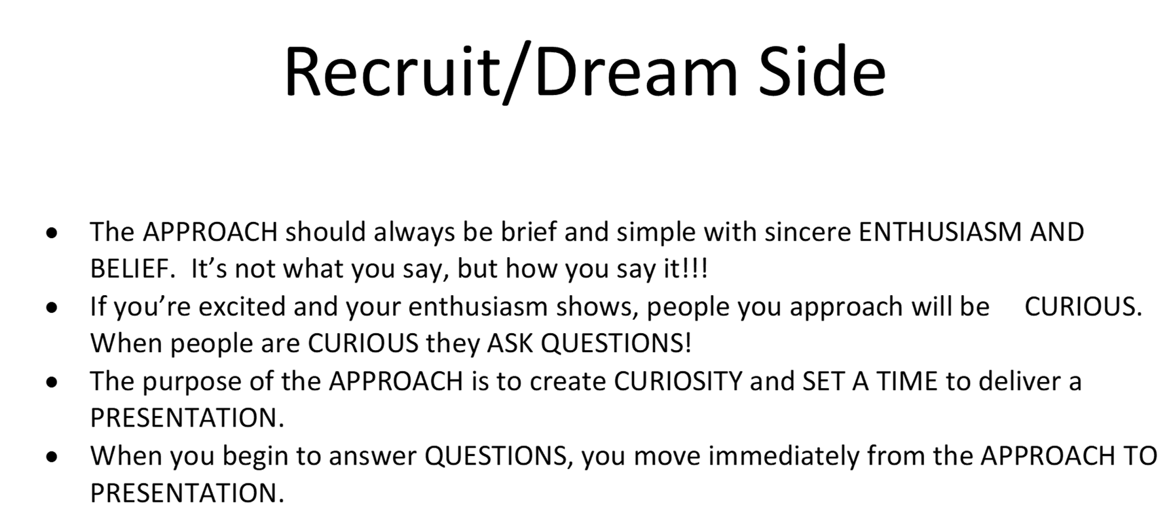

Slide 15
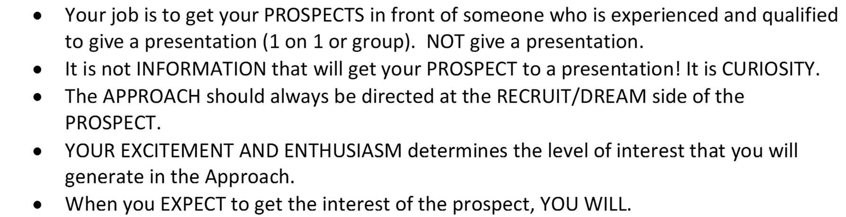

Slide 16
Every Prospect is interested in MAKING AND SAVING MONEY – NOBODY – NO ONE – NOT ANY OF YOUR PROSPECTS ARE INTERESTED IN SELLING INSURANCE – for that matter, they are not interested in BUYING insurance, they are not even interested in TALKING to you or anyone about either of the above. THEREFORE, if you plan to get interest you had best not even THINK about those uninteresting things and you certainly had better not TALK about them!!!

Slide 17
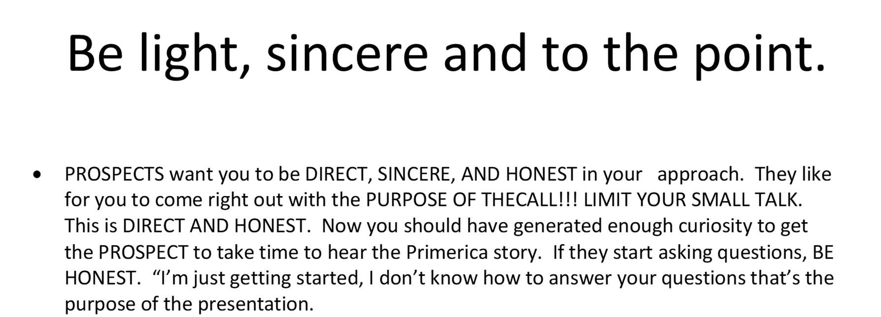

Slide 18
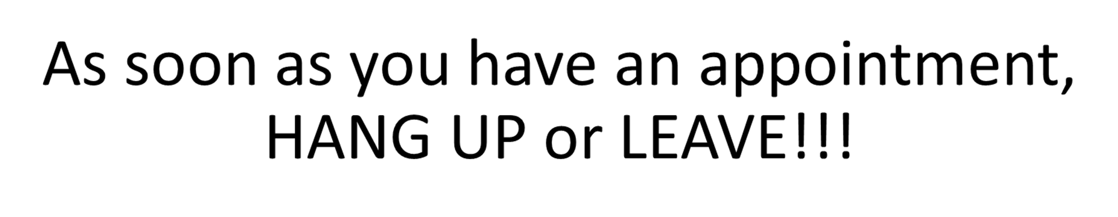

Slide 19


Slide 20
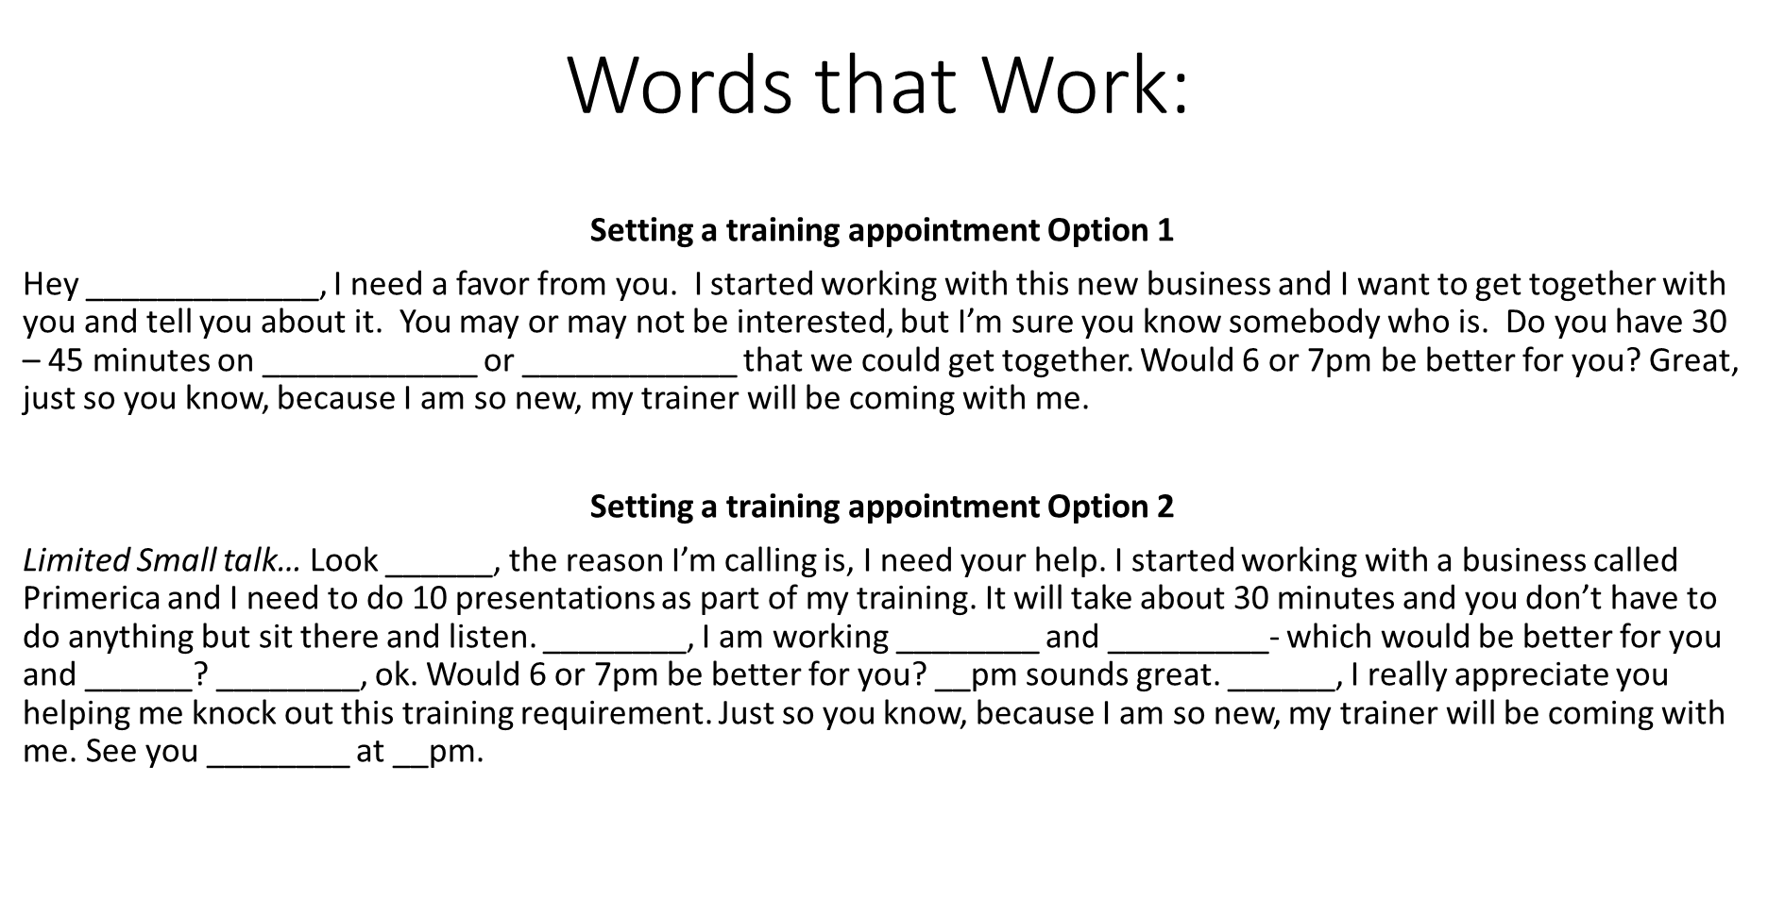

Slide 21


Slide 22
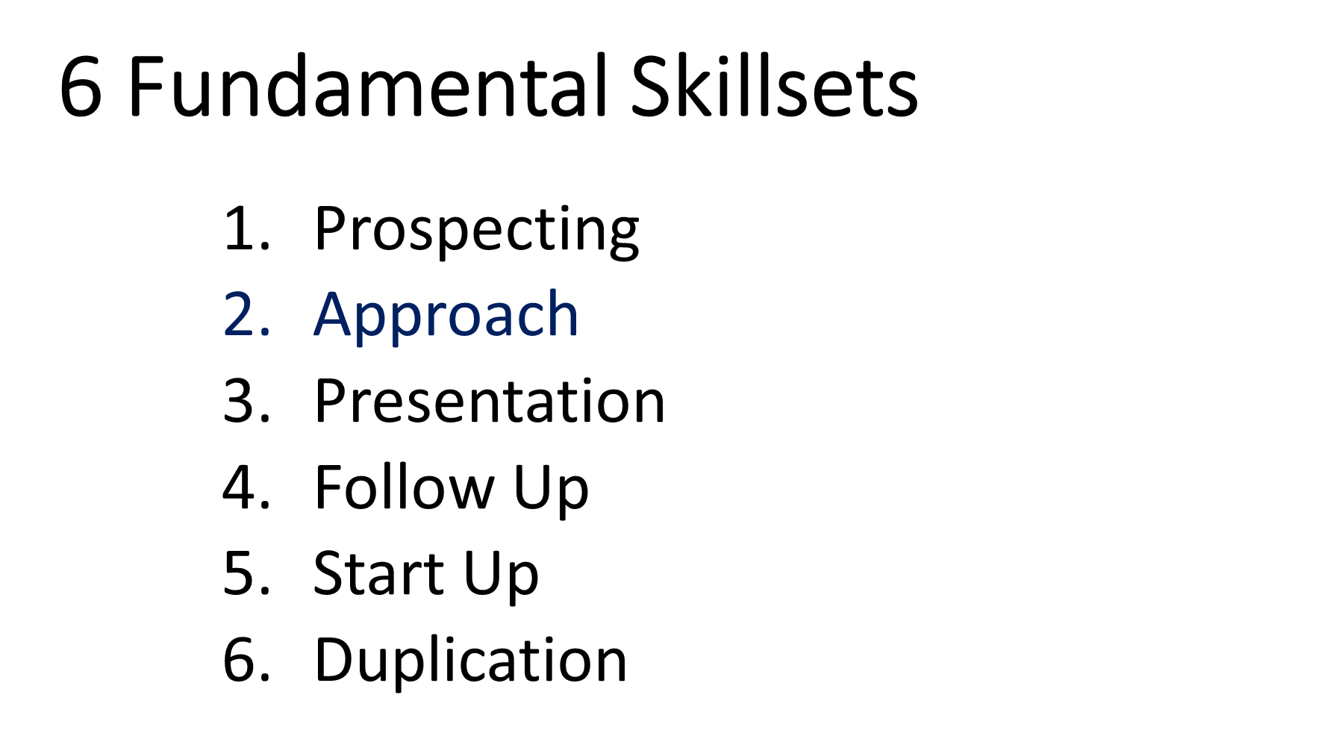

Slide 23
Website: www.avrettarmy.com
Password: team
Facebook Page: Power Run to 21

Slide 24
Next Steps
Get with Field Trainer:
Personalize/ Practice Script
Set appointments
Continue Market development (Memory Jogger)
Attend Next 6 Step Class

Slide 25
Upcoming Schedule

