Slide 1


Fundamentals of Building
System and Processes
Notes:
Trainer Action/Objectives:
Determine new recruits goals & dreams
Begin prospect/inventory list for their business (4 Minute game)
Get weekly calendar (notes on paper)
Have them text a copy of all this to RVP along with their name to get started with their market development & business plan
Share next 6 Step Class

Slide 2


Slide 3
Getting Started:
IBA
Download App
Sign Up on POL

Slide 4
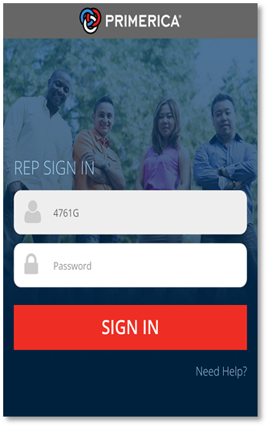
  Apple users: Download the New Primerica App (beta) from the App Store.
  Android users: Download the New Primerica App (beta) from the Google Play Store.
Download in your 1st 24 hours and $50 is added to your Bonus Bank!!!!

Slide 5
What am I paying for?
Business Acceleration System
$99 Initial Amount + $25 Month POL
GA Life License Example
PFS Processing Fee $40.00 Value
PFSU 20-Hour School $350.00 Value
Georgia State Exam $90.00 Value
2-Year Georgia License $150.00 Value
Georgia Temporary License
}
Total Value
$630.00
You Pay $99 Primerica Pays $531
Business Acceleration System
Fast Track $99 Initial Amount + $25 Month POL
Standard $199 Initial Amount
Business Acceleration System
$199 Initial Amount
Business Acceleration System
$199 Initial Amount
Business Acceleration System
Fast Track $99 Initial Amount + $25 Month POL
Standard $199 Initial Amount
Business Acceleration System
$199 Initial Amount
Business Acceleration System
Fast Track $99 Initial Amount + $25 Month POL
Standard $199 Initial Amount
Business Acceleration System
Fast Track $99 Initial Amount + $25 Month POL
Standard $199 Initial Amount
Business Acceleration System
Fast Track $99 Initial Amount + $25 Month POL
Standard $199 Initial Amount
Business Acceleration System
Fast Track $99 Initial Amount + $25 Month POL
Standard $199 Initial Amount
Business Acceleration System
Fast Track $99 Initial Amount + $25 Month POL
Standard $199 Initial Amount
Business Acceleration System
Fast Track $99 Initial Amount + $25 Month POL
Standard $199 Initial Amount
Business Acceleration System
Fast Track $99 Initial Amount + $25 Month POL
Standard $199 Initial Amount
Business Acceleration System
Fast Track $99 Initial Amount + $25 Month POL
Standard $199 Initial Amount
Life & Health License
PFS Processing Fee $40.00 Value
PFSU 40-Hour School $350.00 Value
Georgia State Exam $90.00 Value
1-Year Georgia License $75.00 Value
Georgia Temporary License
PFS Education Center
Life & Health License
PFS Processing Fee $40.00 Value
PFSU 40-Hour School $350.00 Value
Georgia State Exam $90.00 Value
1-Year Georgia License $75.00 Value
Georgia Temporary License
PFS Education Center
Life & Health License
PFS Processing Fee $40.00 Value
PFSU 40-Hour School $350.00 Value
Georgia State Exam $90.00 Value
1-Year Georgia License $75.00 Value
Georgia Temporary License
PFS Education Center
Business Acceleration System
Fast Track $99 Initial Amount + $25 Month POL
Standard $199 Initial Amount
Life & Health License
PFS Processing Fee $40.00 Value
PFSU 40-Hour School $350.00 Value
Georgia State Exam $90.00 Value
1-Year Georgia License $75.00 Value
Georgia Temporary License
PFS Education Center
Life & Health License
PFS Processing Fee $40.00 Value
PFSU 40-Hour School $350.00 Value
Georgia State Exam $90.00 Value
1-Year Georgia License $75.00 Value
Georgia Temporary License
PFS Education Center
Business Acceleration System
Fast Track $99 Initial Amount + $25 Month POL
Standard $199 Initial Amount
}
}
}
Life & Health License
PFS Processing Fee $40.00 Value
PFSU 40-Hour School $350.00 Value
Georgia State Exam $90.00 Value
1-Year Georgia License $75.00 Value
Georgia Temporary License
PFS Education Center
Life & Health License
PFS Processing Fee $40.00 Value
PFSU 40-Hour School $350.00 Value
Georgia State Exam $90.00 Value
1-Year Georgia License $75.00 Value
Georgia Temporary License
PFS Education Center
INCLUDES
INCLUDES
Business Acceleration System
Fast Track $99 Initial Amount + $25 Month POL
Standard $199 Initial Amount
INCLUDES
}
}
Life & Health License
PFS Processing Fee $40.00 Value
PFSU 40-Hour School $350.00 Value
Georgia State Exam $90.00 Value
1-Year Georgia License $75.00 Value
Georgia Temporary License
PFS Education Center
Life & Health License
PFS Processing Fee $40.00 Value
PFSU 40-Hour School $350.00 Value
Georgia State Exam $90.00 Value
1-Year Georgia License $75.00 Value
Georgia Temporary License
PFS Education Center
INCLUDES
Business Acceleration System
Fast Track $99 Initial Amount + $25 Month POL
Standard $199 Initial Amount
INCLUDES
}
}
Life & Health License
PFS Processing Fee $40.00 Value
PFSU 40-Hour School $350.00 Value
Georgia State Exam $90.00 Value
1-Year Georgia License $75.00 Value
Georgia Temporary License
PFS Education Center
Life & Health License
PFS Processing Fee $40.00 Value
PFSU 40-Hour School $350.00 Value
Georgia State Exam $90.00 Value
1-Year Georgia License $75.00 Value
Georgia Temporary License
PFS Education Center
INCLUDES
Business Acceleration System
Fast Track $99 Initial Amount + $25 Month POL
Standard $199 Initial Amount
INCLUDES
}
}
Total Value
$555.00
Total Value
$555.00
Total Value
$555.00
Life & Health License
PFS Processing Fee $40.00 Value
PFSU 40-Hour School $350.00 Value
Georgia State Exam $90.00 Value
1-Year Georgia License $75.00 Value
Georgia Temporary License
PFS Education Center
INCLUDES
INCLUDES
}
}
Total Value
$555.00
Total Value
$555.00
Life & Health License
PFS Processing Fee $40.00 Value
PFSU 40-Hour School $350.00 Value
Georgia State Exam $90.00 Value
1-Year Georgia License $75.00 Value
Georgia Temporary License
PFS Education Center
INCLUDES
INCLUDES
}
Total Value
$555.00
Total Value
$555.00
Life & Health License
PFS Processing Fee $40.00 Value
PFSU 40-Hour School $350.00 Value
Georgia State Exam $90.00 Value
1-Year Georgia License $75.00 Value
Georgia Temporary License
PFS Education Center
INCLUDES
}
Total Value
$555.00
Total Value
$555.00
Life & Health License
PFS Processing Fee $40.00 Value
PFSU 40-Hour School $350.00 Value
Georgia State Exam $90.00 Value
1-Year Georgia License $75.00 Value
Georgia Temporary License
PFS Education Center
INCLUDES
}
Total Value
$555.00
Total Value
$555.00
Life & Health License
PFS Processing Fee $40.00 Value
PFSU 40-Hour School $350.00 Value
Georgia State Exam $90.00 Value
1-Year Georgia License $75.00 Value
Georgia Temporary License
PFS Education Center
INCLUDES
}
Total Value
$555.00
Life & Health License
PFS Processing Fee $40.00 Value
PFSU 40-Hour School $350.00 Value
Georgia State Exam $90.00 Value
1-Year Georgia License $75.00 Value
Georgia Temporary License
PFS Education Center
INCLUDES
}
INCLUDES
Total Value
$555.00
INCLUDES
INCLUDES
Life & Health License
PFS Processing Fee $40.00 Value
PFSU 40-Hour School $350.00 Value
Georgia State Exam $90.00 Value
1-Year Georgia License $75.00 Value
Georgia Temporary License
PFS Education Center
INCLUDES
}
INCLUDES
Total Value
$555.00
INCLUDES
INCLUDES
}
INCLUDES
Total Value
$555.00
INCLUDES
INCLUDES
Total Value
$555.00
INCLUDES
INCLUDES
Total Value
$555.00
INCLUDES
INCLUDES
1. Fundamental Series
Orientation
Prospecting
Approach
Presentation
Follow Up
Start Up
Referrals
FNA Basics
Insurance Basics
Securities Basics
Mortgage Basics
Long Term Care Basics
Variable Annuity Basics
PLPP
2. Field Training
  Access to a Certified Field Trainer
  Client Development – Using the FNA
Market Development Directory
  Team Building
  Using POL
3. Advanced Training Boot Camps
Market Development
Insurance Level 1 & 2
Securities
Loans
Long Term Care
Variable Annuity
Recruiting
FNA
Presentations
4. Skill Development
Phone Skills
Presentation Skills
Getting Referrals
FNA Training
Closing Skills
Completing Forms/Applications
Follow-Up System
PDA/Turbo Apps
Morningstar
5. Field Trainers Development
Advanced Presentation Skills
Cross-Selling of Products
Tap-Root System
Overlapping Leadership
6. Business Development
Time Management
CallAtlanta/POL
Bonus System
EPN
Organizing Your Office
Communication/Processing Systems
(Information Flow)
7. Leadership Development
Communication Skills
Vision Development
Goal Setting
Motivation Skills
Personal Development
Total Value
$555.00
INCLUDES
1. Fundamental Series
Orientation
Prospecting
Approach
Presentation
Follow Up
Start Up
Referrals
FNA Basics
Insurance Basics
Securities Basics
Mortgage Basics
Long Term Care Basics
Variable Annuity Basics
PLPP
2. Field Training
  Access to a Certified Field Trainer
  Client Development – Using the FNA
Market Development Directory
  Team Building
  Using POL
3. Advanced Training Boot Camps
Market Development
Insurance Level 1 & 2
Securities
Loans
Long Term Care
Variable Annuity
Recruiting
FNA
Presentations
4. Skill Development
Phone Skills
Presentation Skills
Getting Referrals
FNA Training
Closing Skills
Completing Forms/Applications
Follow-Up System
PDA/Turbo Apps
Morningstar
5. Field Trainers Development
Advanced Presentation Skills
Cross-Selling of Products
Tap-Root System
Overlapping Leadership
6. Business Development
Time Management
CallAtlanta/POL
Bonus System
EPN
Organizing Your Office
Communication/Processing Systems
(Information Flow)
7. Leadership Development
Communication Skills
Vision Development
Goal Setting
Motivation Skills
Personal Development
1. Fundamental Series
Orientation
Prospecting
Approach
Presentation
Follow Up
Start Up
FNA Basics
Insurance Basics
Securities Basics
Mortgage Basics
Long Term Care Basics
Variable Annuity Basics
PLPP
2. Field Training
  Access to a Certified Field Trainer
  Client Development – Using the FNA
Market Development Directory
  Team Building
  Using POL
3. Advanced Training Boot Camps
Market Development
Insurance Level 1 & 2
Securities
Loans
Long Term Care
Variable Annuity
Recruiting
FNA
Presentations
1. Fundamental Series
Orientation
Prospecting
Approach
Presentation
Follow Up
Start Up
FNA Basics
Insurance Basics
Securities Basics
Mortgage Basics
Long Term Care Basics
Variable Annuity Basics
PLPP
2. Field Training
  Access to a Certified Field Trainer
  Client Development – Using the FNA
Market Development Directory
  Team Building
  Using POL
3. Advanced Training Boot Camps
Market Development
Insurance Level 1 & 2
Securities
Loans
Long Term Care
Variable Annuity
Recruiting
FNA
Presentations
4. Skill Development
Phone Skills
Presentation Skills
Getting Referrals
FNA Training
Closing Skills
Completing Forms/Applications
Follow-Up System
PDA/Turbo Apps
Morningstar
5. Field Trainers Development
Advanced Presentation Skills
Cross-Selling of Products
Tap-Root System
Overlapping Leadership
6. Business Development
Time Management
CallAtlanta/POL
Bonus System
EPN
Organizing Your Office
Communication/Processing Systems
(Information Flow)
7. Leadership Development
Communication Skills
Vision Development
Goal Setting
Motivation Skills
Personal Development
INCLUDES
4. Skill Development
Phone Skills
Presentation Skills
Getting Referrals
FNA Training
Closing Skills
Completing Forms/Applications
Follow-Up System
PDA/Turbo Apps
Morningstar
5. Field Trainers Development
Advanced Presentation Skills
Cross-Selling of Products
Tap-Root System
Overlapping Leadership
6. Business Development
Time Management
CallAtlanta/POL
Bonus System
EPN
Organizing Your Office
Communication/Processing Systems
(Information Flow)
7. Leadership Development
Communication Skills
Vision Development
Goal Setting
Motivation Skills
Personal Development
1. Fundamental Series
Orientation
Prospecting
Approach
Presentation
Follow Up
Start Up
Referrals
FNA Basics
Insurance Basics
Securities Basics
Mortgage Basics
Long Term Care Basics
Variable Annuity Basics
PLPP
2. Field Training
  Access to a Certified Field Trainer
  Client Development – Using the FNA
Market Development Directory
  Team Building
  Using POL
3. Advanced Training Boot Camps
Market Development
Insurance Level 1 & 2
Securities
Loans
Long Term Care
Variable Annuity
Recruiting
FNA
Presentations
1. Fundamental Series
Orientation
Prospecting
Approach
Presentation
Follow Up
Start Up
Referrals
FNA Basics
Insurance Basics
Securities Basics
Mortgage Basics
Long Term Care Basics
Variable Annuity Basics
PLPP
2. Field Training
  Access to a Certified Field Trainer
  Client Development – Using the FNA
Market Development Directory
  Team Building
  Using POL
3. Advanced Training Boot Camps
Market Development
Insurance Level 1 & 2
Securities
Loans
Long Term Care
Variable Annuity
Recruiting
FNA
Presentations
4. Skill Development
Phone Skills
Presentation Skills
Getting Referrals
FNA Training
Closing Skills
Completing Forms/Applications
Follow-Up System
PDA/Turbo Apps
Morningstar
5. Field Trainers Development
Advanced Presentation Skills
Cross-Selling of Products
Tap-Root System
Overlapping Leadership
6. Business Development
Time Management
CallAtlanta/POL
Bonus System
EPN
Organizing Your Office
Communication/Processing Systems
(Information Flow)
7. Leadership Development
Communication Skills
Vision Development
Goal Setting
Motivation Skills
Personal Development
1. Fundamental Series
Orientation
Prospecting
Approach
Presentation
Follow Up
Start Up
FNA Basics
Insurance Basics
Securities Basics
Mortgage Basics
Long Term Care Basics
Variable Annuity Basics
PLPP
2. Field Training
  Access to a Certified Field Trainer
  Client Development – Using the FNA
Market Development Directory
  Team Building
  Using POL
3. Advanced Training Boot Camps
Market Development
Insurance Level 1 & 2
Securities
Loans
Long Term Care
Variable Annuity
Recruiting
FNA
Presentations
4. Skill Development
Phone Skills
Presentation Skills
Getting Referrals
FNA Training
Closing Skills
Completing Forms/Applications
Follow-Up System
PDA/Turbo Apps
Morningstar
5. Field Trainers Development
Advanced Presentation Skills
Cross-Selling of Products
Tap-Root System
Overlapping Leadership
6. Business Development
Time Management
CallAtlanta/POL
Bonus System
EPN
Organizing Your Office
Communication/Processing Systems
(Information Flow)
7. Leadership Development
Communication Skills
Vision Development
Goal Setting
Motivation Skills
Personal Development
INCLUDES
4. Skill Development
Phone Skills
Presentation Skills
Getting Referrals
FNA Training
Closing Skills
Completing Forms/Applications
Follow-Up System
PDA/Turbo Apps
Morningstar
5. Field Trainers Development
Advanced Presentation Skills
Cross-Selling of Products
Tap-Root System
Overlapping Leadership
6. Business Development
Time Management
CallAtlanta/POL
Bonus System
EPN
Organizing Your Office
Communication/Processing Systems
(Information Flow)
7. Leadership Development
Communication Skills
Vision Development
Goal Setting
Motivation Skills
Personal Development
1. Fundamental Series
Orientation
Prospecting
Approach
Presentation
Follow Up
Start Up
Referrals
FNA Basics
Insurance Basics
Securities Basics
Mortgage Basics
Long Term Care Basics
Variable Annuity Basics
PLPP
2. Field Training
  Access to a Certified Field Trainer
  Client Development – Using the FNA
Market Development Directory
  Team Building
  Using POL
3. Advanced Training Boot Camps
Market Development
Insurance Level 1 & 2
Securities
Loans
Long Term Care
Variable Annuity
Recruiting
FNA
Presentations
1. Fundamental Series
Orientation
Prospecting
Approach
Presentation
Follow Up
Start Up
Referrals
FNA Basics
Insurance Basics
Securities Basics
Mortgage Basics
Long Term Care Basics
Variable Annuity Basics
PLPP
2. Field Training
  Access to a Certified Field Trainer
  Client Development – Using the FNA
Market Development Directory
  Team Building
  Using POL
3. Advanced Training Boot Camps
Market Development
Insurance Level 1 & 2
Securities
Loans
Long Term Care
Variable Annuity
Recruiting
FNA
Presentations
4. Skill Development
Phone Skills
Presentation Skills
Getting Referrals
FNA Training
Closing Skills
Completing Forms/Applications
Follow-Up System
PDA/Turbo Apps
Morningstar
5. Field Trainers Development
Advanced Presentation Skills
Cross-Selling of Products
Tap-Root System
Overlapping Leadership
6. Business Development
Time Management
CallAtlanta/POL
Bonus System
EPN
Organizing Your Office
Communication/Processing Systems
(Information Flow)
7. Leadership Development
Communication Skills
Vision Development
Goal Setting
Motivation Skills
Personal Development
INCLUDES
4. Skill Development
Phone Skills
Presentation Skills
Getting Referrals
FNA Training
Closing Skills
Completing Forms/Applications
Follow-Up System
PDA/Turbo Apps
Morningstar
5. Field Trainers Development
Advanced Presentation Skills
Cross-Selling of Products
Tap-Root System
Overlapping Leadership
6. Business Development
Time Management
CallAtlanta/POL
Bonus System
EPN
Organizing Your Office
Communication/Processing Systems
(Information Flow)
7. Leadership Development
Communication Skills
Vision Development
Goal Setting
Motivation Skills
Personal Development
1. Fundamental Series
Orientation
Prospecting
Approach
Presentation
Follow Up
Start Up
Referrals
FNA Basics
Insurance Basics
Securities Basics
Mortgage Basics
Long Term Care Basics
Variable Annuity Basics
PLPP
2. Field Training
  Access to a Certified Field Trainer
  Client Development – Using the FNA
Market Development Directory
  Team Building
  Using POL
3. Advanced Training Boot Camps
Market Development
Insurance Level 1 & 2
Securities
Loans
Long Term Care
Variable Annuity
Recruiting
FNA
Presentations
1. Fundamental Series
Orientation
Prospecting
Approach
Presentation
Follow Up
Start Up
Referrals
FNA Basics
Insurance Basics
Securities Basics
Mortgage Basics
Long Term Care Basics
Variable Annuity Basics
PLPP
2. Field Training
  Access to a Certified Field Trainer
  Client Development – Using the FNA
Market Development Directory
  Team Building
  Using POL
3. Advanced Training Boot Camps
Market Development
Insurance Level 1 & 2
Securities
Loans
Long Term Care
Variable Annuity
Recruiting
FNA
Presentations
4. Skill Development
Phone Skills
Presentation Skills
Getting Referrals
FNA Training
Closing Skills
Completing Forms/Applications
Follow-Up System
PDA/Turbo Apps
Morningstar
5. Field Trainers Development
Advanced Presentation Skills
Cross-Selling of Products
Tap-Root System
Overlapping Leadership
6. Business Development
Time Management
CallAtlanta/POL
Bonus System
EPN
Organizing Your Office
Communication/Processing Systems
(Information Flow)
7. Leadership Development
Communication Skills
Vision Development
Goal Setting
Motivation Skills
Personal Development
INCLUDES
4. Skill Development
Phone Skills
Presentation Skills
Getting Referrals
FNA Training
Closing Skills
Completing Forms/Applications
Follow-Up System
PDA/Turbo Apps
Morningstar
5. Field Trainers Development
Advanced Presentation Skills
Cross-Selling of Products
Tap-Root System
Overlapping Leadership
6. Business Development
Time Management
CallAtlanta/POL
Bonus System
EPN
Organizing Your Office
Communication/Processing Systems
(Information Flow)
7. Leadership Development
Communication Skills
Vision Development
Goal Setting
Motivation Skills
Personal Development
1. Fundamental Series
Orientation
Prospecting
Approach
Presentation
Follow Up
Start Up
Referrals
FNA Basics
Insurance Basics
Securities Basics
Mortgage Basics
Long Term Care Basics
Variable Annuity Basics
PLPP
2. Field Training
  Access to a Certified Field Trainer
  Client Development – Using the FNA
Market Development Directory
  Team Building
  Using POL
3. Advanced Training Boot Camps
Market Development
Insurance Level 1 & 2
Securities
Loans
Long Term Care
Variable Annuity
Recruiting
FNA
Presentations
4. Skill Development
Phone Skills
Presentation Skills
Getting Referrals
FNA Training
Closing Skills
Completing Forms/Applications
Follow-Up System
PDA/Turbo Apps
Morningstar
5. Field Trainers Development
Advanced Presentation Skills
Cross-Selling of Products
Tap-Root System
Overlapping Leadership
6. Business Development
Time Management
CallAtlanta/POL
Bonus System
EPN
Organizing Your Office
Communication/Processing Systems
(Information Flow)
7. Leadership Development
Communication Skills
Vision Development
Goal Setting
Motivation Skills
Personal Development
INCLUDES
1. Fundamental Series
Orientation
Prospecting
Approach
Presentation
Follow Up
Start Up
Referrals
FNA Basics
Insurance Basics
Securities Basics
Mortgage Basics
Long Term Care Basics
Variable Annuity Basics
PLPP
2. Field Training
  Access to a Certified Field Trainer
  Client Development – Using the FNA
Market Development Directory
  Team Building
  Using POL
3. Advanced Training Boot Camps
Market Development
Insurance Level 1 & 2
Securities
Loans
Long Term Care
Variable Annuity
Recruiting
FNA
Presentations
4. Skill Development
Phone Skills
Presentation Skills
Getting Referrals
FNA Training
Closing Skills
Completing Forms/Applications
Follow-Up System
PDA/Turbo Apps
Morningstar
5. Field Trainers Development
Advanced Presentation Skills
Cross-Selling of Products
Tap-Root System
Overlapping Leadership
6. Business Development
Time Management
CallAtlanta/POL
Bonus System
EPN
Organizing Your Office
Communication/Processing Systems
(Information Flow)
7. Leadership Development
Communication Skills
Vision Development
Goal Setting
Motivation Skills
Personal Development
INCLUDES
1. Fundamental Series
Orientation
Prospecting
Approach
Presentation
Follow Up
Start Up
Referrals
FNA Basics
Insurance Basics
Securities Basics
Mortgage Basics
Long Term Care Basics
Variable Annuity Basics
PLPP
2. Field Training
  Access to a Certified Field Trainer
  Client Development – Using the FNA
Market Development Directory
  Team Building
  Using POL
3. Advanced Training Boot Camps
Market Development
Insurance Level 1 & 2
Securities
Loans
Long Term Care
Variable Annuity
Recruiting
FNA
Presentations
4. Skill Development
Phone Skills
Presentation Skills
Getting Referrals
FNA Training
Closing Skills
Completing Forms/Applications
Follow-Up System
PDA/Turbo Apps
Morningstar
5. Field Trainers Development
Advanced Presentation Skills
Cross-Selling of Products
Tap-Root System
Overlapping Leadership
6. Business Development
Time Management
CallAtlanta/POL
Bonus System
EPN
Organizing Your Office
Communication/Processing Systems
(Information Flow)
7. Leadership Development
Communication Skills
Vision Development
Goal Setting
Motivation Skills
Personal Development
1. Fundamental Series
Orientation
Prospecting
Approach
Presentation
Follow Up
Start Up
Referrals
FNA Basics
Insurance Basics
Securities Basics
Mortgage Basics
Long Term Care Basics
Variable Annuity Basics
PLPP
2. Field Training
  Access to a Certified Field Trainer
  Client Development – Using the FNA
Market Development Directory
  Team Building
  Using POL
3. Advanced Training Boot Camps
Market Development
Insurance Level 1 & 2
Securities
Loans
Long Term Care
Variable Annuity
Recruiting
FNA
Presentations
4. Skill Development
Phone Skills
Presentation Skills
Getting Referrals
FNA Training
Closing Skills
Completing Forms/Applications
Follow-Up System
PDA/Turbo Apps
Morningstar
5. Field Trainers Development
Advanced Presentation Skills
Cross-Selling of Products
Tap-Root System
Overlapping Leadership
6. Business Development
Time Management
CallAtlanta/POL
Bonus System
EPN
Organizing Your Office
Communication/Processing Systems
(Information Flow)
7. Leadership Development
Communication Skills
Vision Development
Goal Setting
Motivation Skills
Personal Development
1. Fundamental Series
Orientation
Prospecting
Approach
Presentation
Follow Up
Start Up
Referrals
FNA Basics
Insurance Basics
Securities Basics
Mortgage Basics
Long Term Care Basics
Variable Annuity Basics
PLPP
2. Field Training
  Access to a Certified Field Trainer
  Client Development – Using the FNA
Market Development Directory
  Team Building
  Using POL
3. Advanced Training Boot Camps
Market Development
Insurance Level 1 & 2
Securities
Loans
Long Term Care
Variable Annuity
Recruiting
FNA
Presentations
4. Skill Development
Phone Skills
Presentation Skills
Getting Referrals
FNA Training
Closing Skills
Completing Forms/Applications
Follow-Up System
PDA/Turbo Apps
Morningstar
5. Field Trainers Development
Advanced Presentation Skills
Cross-Selling of Products
Tap-Root System
Overlapping Leadership
6. Business Development
Time Management
CallAtlanta/POL
Bonus System
EPN
Organizing Your Office
Communication/Processing Systems
(Information Flow)
7. Leadership Development
Communication Skills
Vision Development
Goal Setting
Motivation Skills
Personal Development
1. Fundamental Series
Orientation
Prospecting
Approach
Presentation
Follow Up
Start Up
Referrals
FNA Basics
Insurance Basics
Securities Basics
Mortgage Basics
Long Term Care Basics
Variable Annuity Basics
PLPP
2. Field Training
  Access to a Certified Field Trainer
  Client Development – Using the FNA
Market Development Directory
  Team Building
  Using POL
3. Advanced Training Boot Camps
Market Development
Insurance Level 1 & 2
Securities
Loans
Long Term Care
Variable Annuity
Recruiting
FNA
Presentations
4. Skill Development
Phone Skills
Presentation Skills
Getting Referrals
FNA Training
Closing Skills
Completing Forms/Applications
Follow-Up System
PDA/Turbo Apps
Morningstar
5. Field Trainers Development
Advanced Presentation Skills
Cross-Selling of Products
Tap-Root System
Overlapping Leadership
6. Business Development
Time Management
CallAtlanta/POL
Bonus System
EPN
Organizing Your Office
Communication/Processing Systems
(Information Flow)
7. Leadership Development
Communication Skills
Vision Development
Goal Setting
Motivation Skills
Personal Development
1. Fundamental Series
Orientation
Prospecting
Approach
Presentation
Follow Up
Start Up
Referrals
FNA Basics
Insurance Basics
Securities Basics
Mortgage Basics
Long Term Care Basics
Variable Annuity Basics
PLPP
2. Field Training
  Access to a Certified Field Trainer
  Client Development – Using the FNA
Market Development Directory
  Team Building
  Using POL
3. Advanced Training Boot Camps
Market Development
Insurance Level 1 & 2
Securities
Loans
Long Term Care
Variable Annuity
Recruiting
FNA
Presentations
4. Skill Development
Phone Skills
Presentation Skills
Getting Referrals
FNA Training
Closing Skills
Completing Forms/Applications
Follow-Up System
PDA/Turbo Apps
Morningstar
5. Field Trainers Development
Advanced Presentation Skills
Cross-Selling of Products
Tap-Root System
Overlapping Leadership
6. Business Development
Time Management
CallAtlanta/POL
Bonus System
EPN
Organizing Your Office
Communication/Processing Systems
(Information Flow)
7. Leadership Development
Communication Skills
Vision Development
Goal Setting
Motivation Skills
Personal Development
7
7
For educational and training purposes only.
7
For educational and training purposes only.
For educational and training purposes only.
Version 3
Version 3
Version 3
7
For educational and training purposes only.
7
For educational and training purposes only.
Version 3
Version 3
7
For educational and training purposes only.
7
For educational and training purposes only.
Version 8
Version 3
7
For educational and training purposes only.
7
For educational and training purposes only.
Version 3
Version 8
7
For educational and training purposes only.
7
For educational and training purposes only.
Version 3
For educational and training purposes only.
Version 3
7
For educational and training purposes only.
Version 3
7
For educational and training purposes only.
Version 3
7
For educational and training purposes only.
Version 3
7
For educational and training purposes only.
Version 3
7
For educational and training purposes only.
Version 3
7
For educational and training purposes only.
Version 3
7
Version 3

Slide 6


Slide 7
Step One:
Download the App
Create your POL Logon

Slide 8
Primerica Online
Get Plugged in Fast!
Register to access Primerica Online at www.primericaonline.com
You need your solution number to get access to Primerica Online

Slide 9
Is this real?
Listed on NYSE as PRI
Over 140,000 Life Licensed Representatives
Founded over 44 Years Ago
Largest Marketer of Financial Services in North America

Slide 10
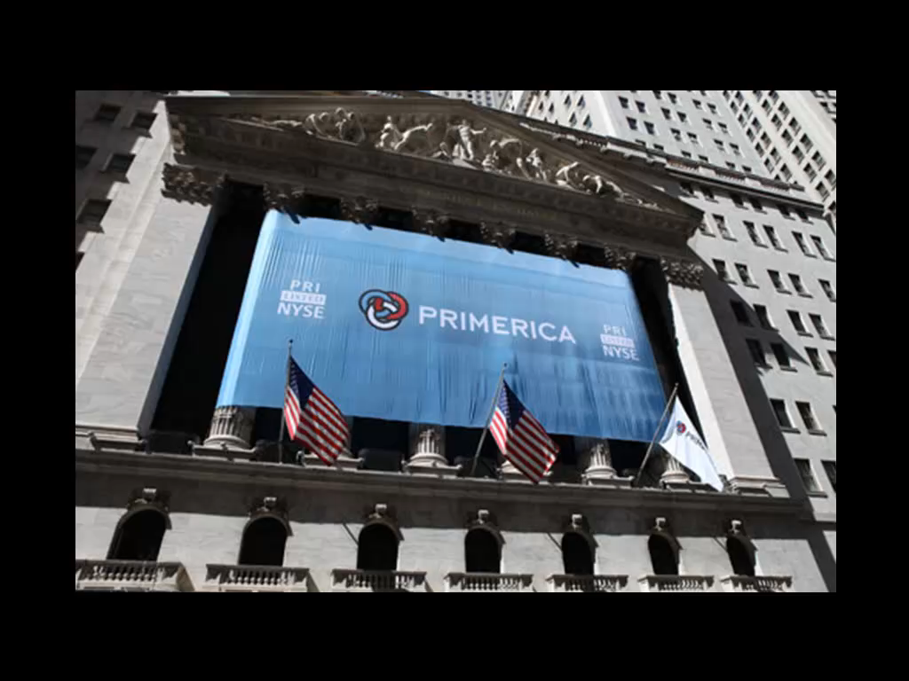

Slide 11
All of whom started exactly where you are right now!!
More individuals earning over $100,000 than any other company, public or private in North America
More individuals earning over $1,000,000 than any other company, public and private, in North America

Slide 12
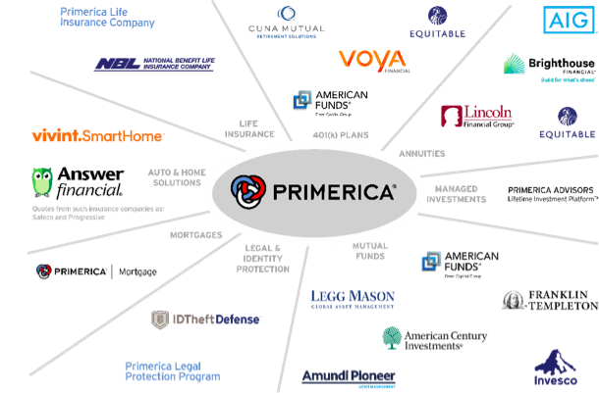
Some of Our Partners:

Slide 13
How will I do this?
Our Systems and Processes are time tested and proven. If you commit to following these, to staying coachable, to working in your business you will be successful in Primerica.
Whether you came here to make $500,000 a year, $50,000 a year or $500 a month – we have a plan for you.
We will coach you, show you and teach you EVERYTHING you need to know!!

Slide 14
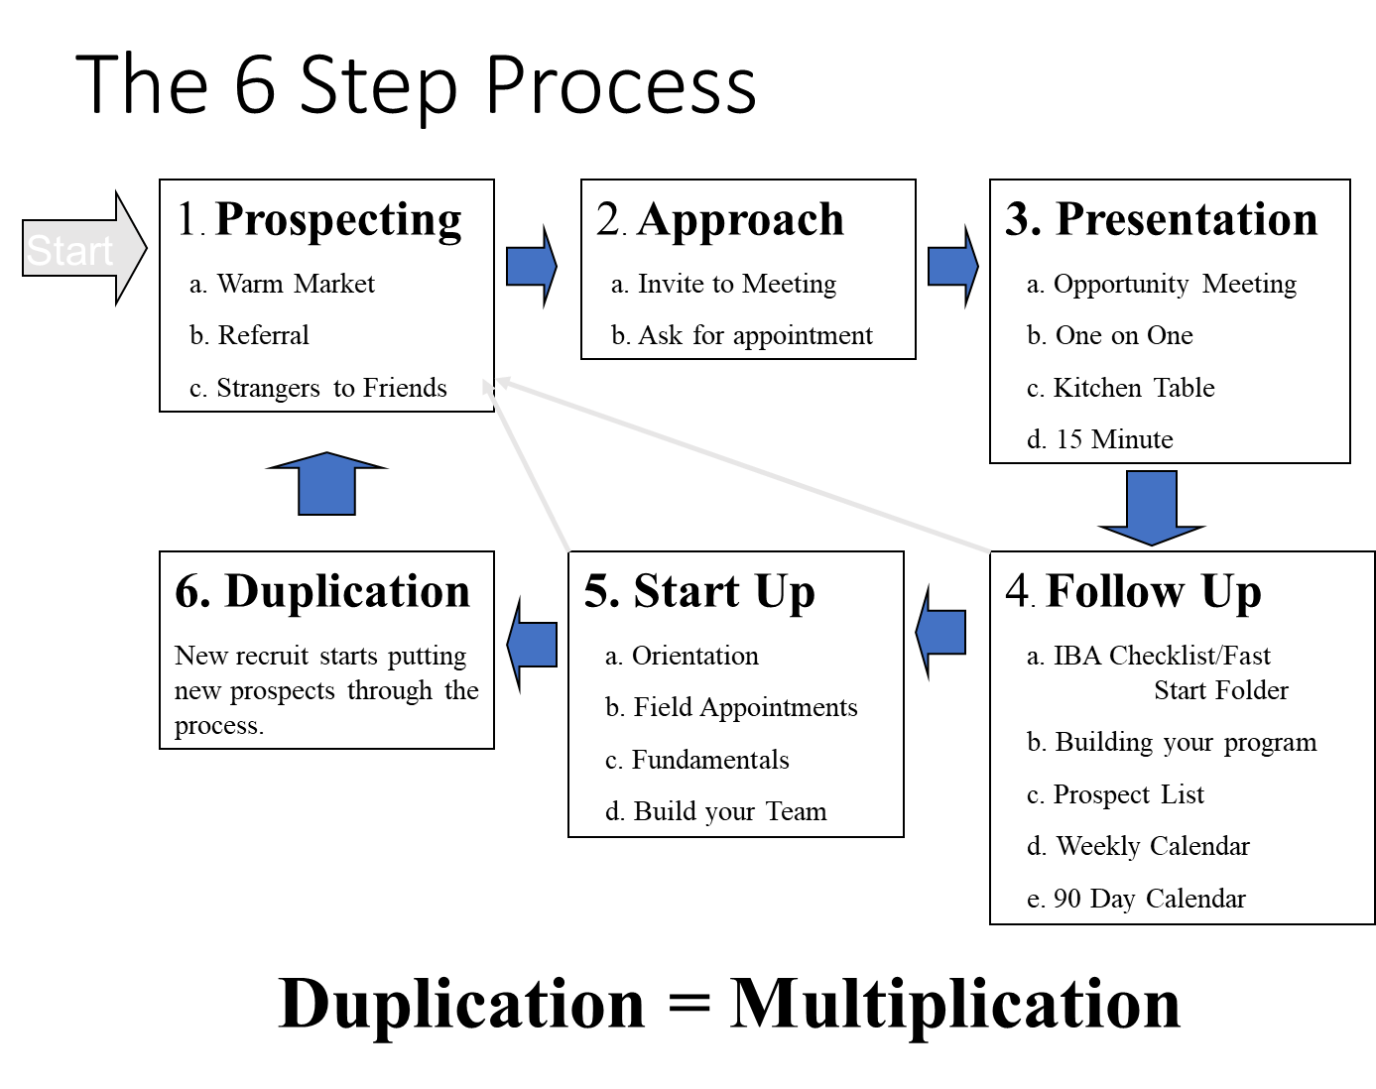

Slide 15
First 90 Days-You and Your Upline
Build your prospect list
Recruit at least three new representatives into your business
Complete your own insurance program.
Attend a business overview session.
Attend Weekly Training
Add names to your marketing contact list

Slide 16
First 90 Days-You and Your Upline
Work toward the bonus
Work toward your insurance license
Begin a personal improvement program
  Time Management
  Public Speaking
  Leadership
Practice and rehearse the PRIMERICA presentation

Slide 17
How will I Learn to Build?
Field Training
Fundamentals Training:
Orientation
Prospecting
Approach
Presentation
Follow Up
Start Up
Referrals
Overcoming Objections
Advanced Training Boot Camps

Slide 18
How will I learn about products?
Field Training
Fundamentals Training:
Insurance Basics
Securities Basics
Auto & Home Solutions
Advanced Training Boot Camps

Slide 19
What Happens to MY list?
You bring enthusiasm and a prospect list to the table.
We bring knowledge and experience to the table.
Together, we will successfully help you build a team.

Slide 20
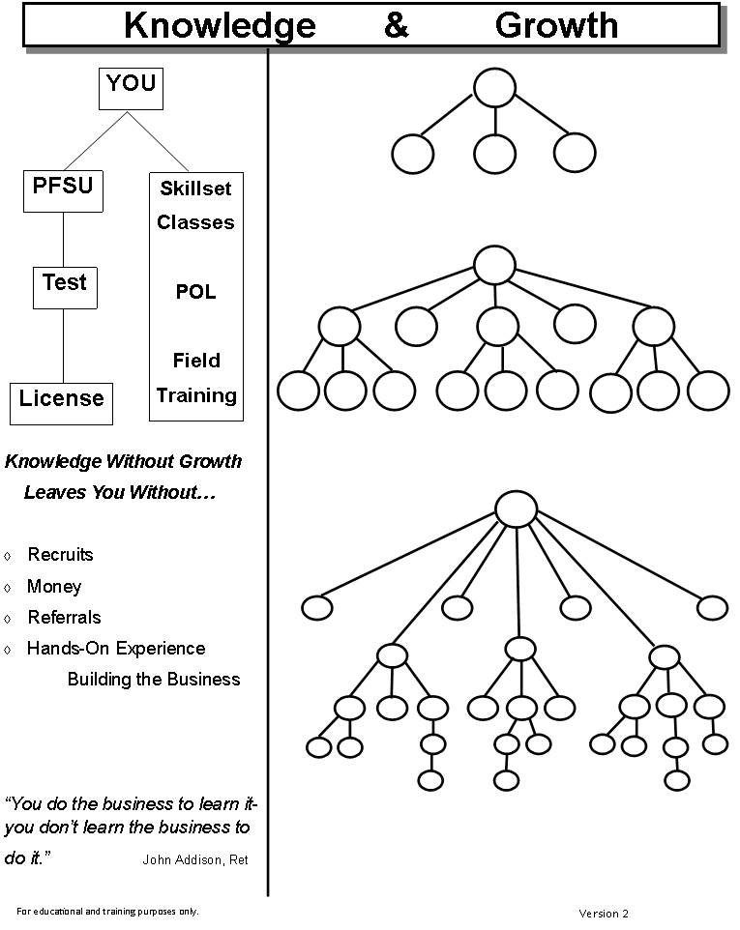

Slide 21
Field Training Bonus

Slide 22
Important Vocabulary
FTO – Field Training Observation
Premium – amount client pays for policy
BP – Bonusable Premium – client annual premium
Unit – 1 personal recruit + 1000BP
Exchange – 1st three life sales in your market given up to activate your license

Slide 23
Client Annual Premium Example:
Client pays $83.33 per month
X 12 months
1000 = Bonusable Premium (BP)

Slide 24
How you get paid before licensed
Bank $200 for every Unit in your Field Training Process!!!!!
Unit = 1 Personal Recruit + 1000BP FTO = $200
5 Units + your logon bonus = $1050!!!!!!
Qualify for Unlimited Units!!!!
Put your field leader to work for you, build your team and get paid!!
It’s a win win!!!!
*must complete PFSU in 60 days and pass your life license in 90 to qualify
District Promotion
50%

Slide 25
District Leader Commission Example
1000 BP
-75 Policy Fee
925 Total Commission
X 50% District Level
$462.50 Total Commission
X 75% Advance
$346.88 Advance Commission

Slide 26
Field Training
As a new representative with PRIMERICA , your family, friends, work associates, etc. will base most of their decisions about the company on the impression you give them. The people you talk to want to know you are excited, focused and determined. A positive, excited, tough, and committed attitude is attractive to other people.

Slide 27
Field Training
Your field trainer will help you with the following activities:
Help you get off to a fast start
Help you get licensed
Teach you product knowledge
Remember, it’s important for you to be coachable during this early phase of your career. Your field trainer will show you the methods of building a successful business that works and those that don’t work.

Slide 28
Field Training
Knowledge doesn’t produce activity - activity produces knowledge.

Slide 29
Buy Term and Invest the Difference will always be the heart of our business!!
Approach – talk about the opportunity and making dreams come true!!

Slide 30
The tools are in place!
The training is in place!
The trainers are in place!
Everything you need is at your fingertips!!!
Build your business BIG & FAST!!

Slide 43
4 Minute Game

Slide 44


Slide 47
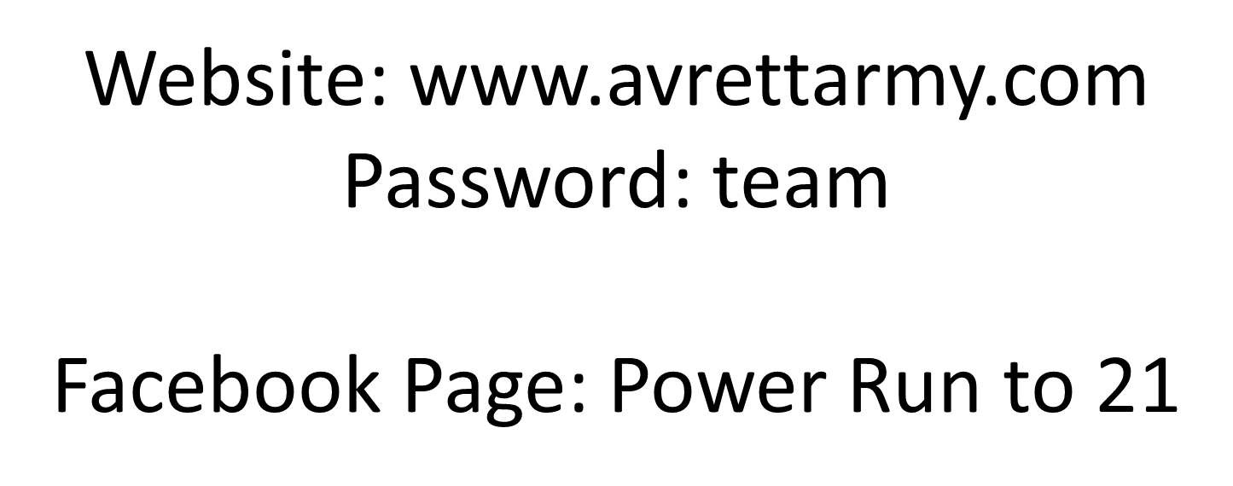

Slide 48
Next Steps:
Get with Field trainer:
Share goals & dreams
Discuss weekly calendar
Develop market (complete & discuss Top 10)
Set Appointments
Determine dollar amount they need monthly to accomplish their short-term financial goals discussed

Slide 49
Upcoming Schedule

